Slide 1
DATA-DRIVEN TURBINE PERFORMANCE ANALYSIS
Team 7
Texas A&M University

Slide 2
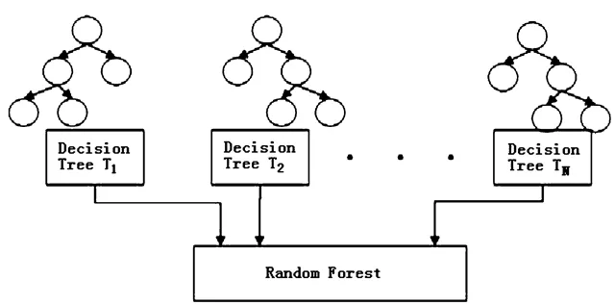
Random Forest: Simple Model
n_estimators = T_{N}
oob_score = True
Evaluation
Evaluation
Evaluation
min_samples_leaf =1
https://medium.com/all-things-ai/in-depth-parameter-tuning-for-random-forest-d67bb7e920d

Slide 3
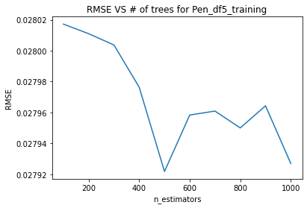
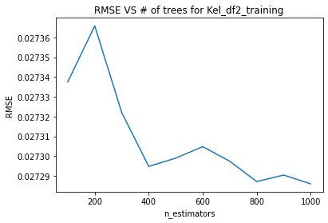
Random Forest: Training & Tuning
Split 80% training and 20% for validation.
Train on one turbine per location: not optimal, but faster.

Slide 4
Random Forest: Results & Remarks
Criteria | MAE | RMSE
Score | 0.0160 | 0.0281
Further improvement with search grid.
Further improvement with training the model for each turbine.
However, run time is going to be an issue.

Slide 5
XGBoost: Model
Same model structure as RandomForest
One key difference is ensemble method (boosting vs bagging)
Much faster
Parameters:
'learning_rate': 0.05, shrinkage of the weights of the new trees that are added to the ensemble during the boosting process. Small values prevent overfitting.
'max_depth': 8, maximum number of levels or nodes that a decision tree can have.
'subsample': 0.7, fraction of observations to be randomly sampled for each tree.
'colsample_bytree': 0.9, controls the fraction of features (columns) to be randomly sampled for each tree in the ensemble
'n_estimators': 400, number of trees

Slide 6
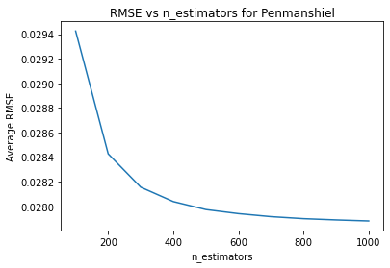
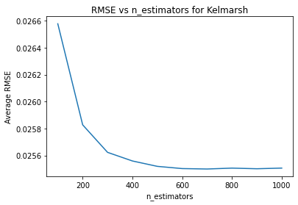
XGBoost: Training & Tuning
Split 80% training and 20% for validation.
Train on one all turbines per location: n_estimators only

Slide 7
XGBoost: Results & Remarks
Criteria | MAE | RMSE
XGBoost | 0.0146 | 0.0262
RandomForest | 0.0160 | 0.0281
Better than RandomForest
Much faster than random forest
Expected to perform even better when fully tuned

Slide 8
General Procedure
For All methods we used from DSWE:
We used +/- 1 encoding for day/night in both training and test datasets.
We used 1:12 encoding for the months in both training and test datasets.

Slide 9
DSWE package in R: Results
Sorted Based on MAE
Sorted Based on RMSE
Methods | Grand MAE
TempGP | 0.0162
BART | 0.0167
SVM | 0.0171
AMK | 0.0199
KNN | 0.0264
Methods | Grand RMSE
SVM | 0.0289
BART | 0.0295
TempGP | 0.0300
AMK | 0.0325
KNN | 0.0416

Slide 10
Thank You
For Your Attention

